Slide 1
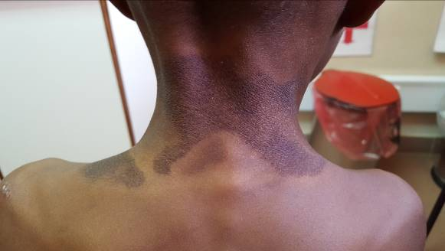
Isoniazid prophylaxis therapy completion rate and side effects among children on care and treatment in Mwanza, Tanzania
J. Gwimile¹, I. Mteta¹, J. Kidola², A. Gesase¹, L. Mwita¹, M. Minde¹, V. Ip^{1, 3}
¹Baylor College of Medicine Children's Foundation Tanzania, ²National Institute of Medical Research Tanzania, ³Baylor College of Medicine International Pediatric AIDS initiatives, USA
Background
WHO and NTLP recommends that all children who are living with HIV need to receive isoniazid preventive therapy (IPT) once screened negative for tuberculosis.
Pyridoxine is recommended as a supplement to avoid vitamin B6 deficiency to all clients on IPT.
Pyridoxine availability remains a challenge in Tanzania resulting in many children with side effects due to vitamin B6 deficiency.
Low IPT completion rate has been associated with side effects, but there is limited data to support impact of vitamin B6 deficiency as a side effect on completion rate.
This study assesses the IPT completion rate in absence of pyridoxine supplementation among children attending HIV services at Baylor Center of Excellence (COE) in Mwanza, Tanzania.
Method
This is a retrospective cohort study of 548 children on IPT between July, 2014 and May, 2018 at the Mwanza COE.
Information on date of IPT initiation, completion, discontinuation, nutritional status, weight, and ART regimen was gathered.
Data on reported or experienced side effects was also collected. Descriptive analysis was done using histograms for shape distributions.
Cohort characteristics are presented as medians and interquartile ranges, means and standard deviations (SD), or percentages as appropriate.
Chi-square tests were used to compare different characteristics between those who completed and did not complete IPT.
Results
A total of 548 children on IPT were recruited, of which 278 (50.7%) were male, mean age was 10 years (SD 4.2)
11 (2%) had a TB contact, 452 (82.5%) were on NVP/EFV, 96 (17.5%) were on a LPV/r-based regimen and 13 (2.4%) were malnourished. Of those enrolled, mortality rate was low (n=1, 0.2%) and 10 (1.8%) were transferred out before IPT completion.
IPT completion rate was 88.9% (487/548) at the end of six months as per guidelines. 11.3% (62/548) reported to experience side effects to IPT.
Reported side effects included skin lesions (54.8%, 34/62), peripheral neuropathy (21%, 13/62), vomiting and weight loss (14.5%, 9/62), poor energy and depression (9.7%, 6/62), and anemia (6.5%, 4/62).
The major reasons for not completing IPT were due to side effects from isoniazid (32.8%, 20/61), and poor adherence (19.7%, 12/61).
Conclusion
IPT completion rate was good, however, amongst children who experienced side effects it was poor.
Major side effects such as peripheral neuropathy, rashes, and weight loss are significant contributors to IPT non-completion.
IPT completion rate was good among children who live with HIV. Those who did not complete IPT were more likely to have experienced side effects to isoniazid.
Table 1. Comparison between those completing vs. not completing IPT.
Variable | Completed IPT |  | Did not complete IPT
 | N | % | N | % | p-value
Total N | 487 |  | 61
INH side effects | 3 | 0.6% | 20 | 32.8% | <0.01
Peripheral Neuropathy | 1 | 0.2% | 8 | 13.1% | <0.01
Rashes | 2 | 0.4% | 8 | 13.1% | <0.01
Lost weight | 11 | 2.3% | 22 | 78.6% | <0.01
Average Wt change (SD) | 1.4 | SD=1.6 | -0.7 | SD=2.30 | <0.01
Figure 1. Skin lesions associated with IPT.
PRESENTED AT THE 23RD INTERNATIONAL AIDS CONFERENCE (AIDS 2020) | 6-10 JULY 2020

